Slide 1
Application Layer
Notes:
Version History
8.1. Updates throughout, including a lot more animations. These are the ppt files used to make Chapter 2 online lectures in Sept. 2020.
8.0 (April 2020)
All slides reformatted for 16:9 aspect ratio
All slides updated to 8th edition material
Use of Calibri font, rather that Gill Sans MT
Add LOTS more animation throughout

Slide 2
Application architectures
possible structure of applications:
client-server
peer-to-peer (P2P)

Slide 3








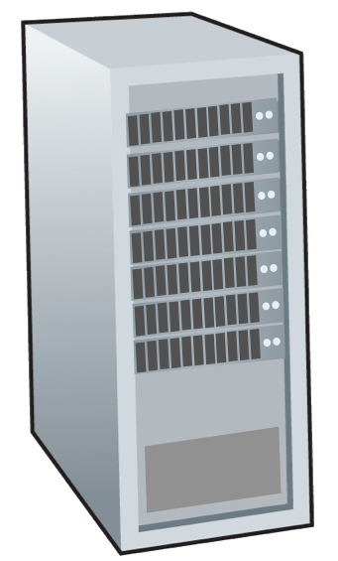







Client-server paradigm
server:
always-on host
permanent IP address
often in data centers, for scaling
clients:
contact, communicate with server
may have dynamic IP addresses
do not communicate directly with each other
examples: HTTP, IMAP, FTP
mobile network
national or global ISP
local or regional ISP
home network
content
provider
network
datacenter
network
enterprise
network

Slide 4
Peer-peer architecture
no always-on server
arbitrary end systems directly communicate
peers request service from other peers, provide service in return to other peers
self scalability – new peers bring new service capacity, as well as new service demands
example: P2P file sharing
mobile network
national or global ISP
local or regional ISP
home network
content
provider
network
datacenter
network
enterprise
network

Slide 5
Processes communicating
process: program running within a host
within same host, two processes communicate using inter-process communication (defined by OS)
processes in different hosts communicate by exchanging messages
clients, servers
client process: process that initiates communication
server process: process that waits to be contacted
note: applications with P2P architectures have client processes & server processes

Slide 6

Sockets
process sends/receives messages to/from its socket
socket analogous to door
sending process shoves message out door
sending process relies on transport infrastructure on other side of door to deliver message to socket at receiving process
two sockets involved: one on each side
application
socket
application
controlled by
app developer
process
process
transport
transport
network
network
controlled
by OS
link
Internet
link
physical
physical

Slide 7
Addressing processes
to receive messages, process must have identifier
host device has unique 32-bit IP address
Q: does IP address of host on which process runs suffice for identifying the process?
identifier includes both IP address and port numbers associated with process on host.
example port numbers:
HTTP server: 80
mail server: 25
to send HTTP message to gaia.cs.umass.edu web server:
IP address: 128.119.245.12
port number: 80
more shortly…
A: no, many processes can be running on same host

Slide 8
An application-layer protocol defines:
types of messages exchanged,
e.g., request, response
message syntax:
what fields in messages & how fields are delineated
message semantics
meaning of information in fields
rules for when and how processes send & respond to messages

Slide 9
What transport service does an app need?
data integrity
some apps (e.g., file transfer, web transactions) require 100% reliable data transfer
other apps (e.g., audio) can tolerate some loss
throughput
some apps (e.g., multimedia) require minimum amount of throughput to be “effective”
other apps (“elastic apps”) make use of whatever throughput they get
timing
some apps (e.g., Internet telephony, interactive games) require low delay to be “effective”
security
encryption, data integrity, …

Slide 10
Transport service requirements: common apps
application
file transfer/download
e-mail
Web documents
real-time audio/video
streaming audio/video
interactive games
text messaging
data loss
no loss
no loss
no loss
loss-tolerant
loss-tolerant
loss-tolerant
no loss
throughput
elastic
elastic
elastic
audio: 5Kbps-1Mbps
video:10Kbps-5Mbps
same as above
Kbps+
elastic
time sensitive?
no
no
no
yes, 10’s msec
yes, few secs
yes, 10’s msec
yes and no

Slide 11
Internet transport protocols services
TCP service:
reliable transport between sending and receiving process
flow control: sender won’t overwhelm receiver
congestion control: throttle sender when network overloaded
connection-oriented: setup required between client and server processes
does not provide: timing, minimum throughput guarantee, security
UDP service:
unreliable data transfer between sending and receiving process
does not provide: reliability, flow control, congestion control, timing, throughput guarantee, security, or connection setup.
Q: why bother? Why is there a UDP?

Slide 12
Internet applications, and transport protocols
application
layer protocol
FTP [RFC 959]
SMTP [RFC 5321]
HTTP 1.1 [RFC 7320]
SIP [RFC 3261], RTP [RFC 3550], or proprietary HTTP [RFC 7320], DASH
WOW, FPS (proprietary)
application
file transfer/download
e-mail
Web documents
Internet telephony
streaming audio/video
interactive games
transport protocol
TCP
TCP
TCP
TCP or UDP
TCP
UDP or TCP

Slide 13
Web and HTTP
First, a quick review…
web page consists of objects, each of which can be stored on different Web servers
object can be HTML file, JPEG image, audio file,…
web page consists of base HTML-file which includes several referenced objects, each addressable by a URL, e.g.,
www.someschool.edu/someDept/pic.gif
host name
path name

Slide 14

HTTP overview
HTTP: hypertext transfer protocol
Web’s application-layer protocol
client/server model:
client: browser that requests, receives, (using HTTP protocol) and “displays” Web objects
server: Web server sends (using HTTP protocol) objects in response to requests
HTTP request
PC running
Firefox browser
HTTP response
HTTP request
server running
Apache Web
server
HTTP response
iPhone running
Safari browser

Slide 15
HTTP overview (continued)
HTTP uses TCP:
client initiates TCP connection (creates socket) to server, port 80
server accepts TCP connection from client
HTTP messages (application-layer protocol messages) exchanged between browser (HTTP client) and Web server (HTTP server)
TCP connection closed
HTTP is “stateless”
server maintains no information about past client requests
aside
protocols that maintain “state” are complex!
past history (state) must be maintained
if server/client crashes, their views of “state” may be inconsistent, must be reconciled

Slide 16
HTTP connections: two types
Non-persistent HTTP
TCP connection opened
at most one object sent over TCP connection
TCP connection closed
downloading multiple objects required multiple connections
Persistent HTTP
TCP connection opened to a server
multiple objects can be sent over single TCP connection between client, and that server
TCP connection closed

Slide 17
Non-persistent HTTP: example
User enters URL:
www.someSchool.edu/someDepartment/home.index
(containing text, references to 10 jpeg images)
1a. HTTP client initiates TCP connection to HTTP server (process) at www.someSchool.edu on port 80
1b. HTTP server at host www.someSchool.edu waiting for TCP connection at port 80 “accepts” connection, notifying client
2. HTTP client sends HTTP request message (containing URL) into TCP connection socket. Message indicates that client wants object someDepartment/home.index
3. HTTP server receives request message, forms response message containing requested object, and sends message into its socket
time

Slide 18
Non-persistent HTTP: example (cont.)
User enters URL:
www.someSchool.edu/someDepartment/home.index
(containing text, references to 10 jpeg images)
4. HTTP server closes TCP connection.
5. HTTP client receives response message containing html file, displays html. Parsing html file, finds 10 referenced jpeg objects
6. Steps 1-5 repeated for each of 10 jpeg objects
time

Slide 19
Non-persistent HTTP: response time
RTT (Round Trip Time): time for a small packet to travel from client to server and back
HTTP response time (per object):
one RTT to initiate TCP connection
one RTT for HTTP request and first few bytes of HTTP response to return
obect/file transmission time
initiate TCP
connection
RTT
request file
RTT
time to
transmit
file
file received
time
time
Non-persistent HTTP response time = 2RTT+ file transmission time

Slide 20
Persistent HTTP (HTTP 1.1)
Non-persistent HTTP issues:
requires 2 RTTs per object
OS overhead for each TCP connection
browsers often open multiple parallel TCP connections to fetch referenced objects in parallel
Persistent HTTP (HTTP1.1):
server leaves connection open after sending response
subsequent HTTP messages between same client/server sent over open connection
client sends requests as soon as it encounters a referenced object

Slide 21
HTTP request messages
POST method (HTTP 1.0):
web page often includes form input
user input sent from client to server in entity body of HTTP POST request message
HEAD method (HTTP 1.0):
requests headers (only) that would be returned if specified URL were requested with an HTTP GET method.
PUT method (HTTP 1.1):
uploads new file (object) to server
completely replaces file that exists at specified URL with content in entity body of POST HTTP request message
GET method (HTTP 1.0) (for sending data to server):
include user data in URL field of HTTP GET request message (following a ‘?’):
www.somesite.com/animalsearch?monkeys&banana

Slide 22
HTTP response status codes
status code appears in 1st line in server-to-client response message.
some sample codes:
200 OK
request succeeded, requested object later in this message
301 Moved Permanently
requested object moved, new location specified later in this message (in Location: field)
400 Bad Request
request msg not understood by server
404 Not Found
requested document not found on this server
505 HTTP Version Not Supported

Slide 23

Maintaining user/server state: cookies
Recall: HTTP GET/response interaction is stateless
no notion of multi-step exchanges of HTTP messages to complete a Web “transaction”
no need for client/server to track “state” of multi-step exchange
all HTTP requests are independent of each other
no need for client/server to “recover” from a partially-completed-but-never-completely-completed transaction
a stateful protocol: client makes two changes to X, or none at all
X
lock data record X
X
OK
update X X’
X’
OK
t’
update X X’’
OK
X’’
unlock X
OK
X’’
time
time
Q: what happens if network connection or client crashes at t’ ?
Notes:
t’

Slide 24
Maintaining user/server state: cookies
Web sites and client browser use cookies to maintain some state between transactions
four components:
1) cookie header line of HTTP response message
2) cookie header line in next HTTP request message
3) cookie file kept on user’s host, managed by user’s browser
4) back-end database at Web site
Example:
Susan uses browser on laptop, visits specific e-commerce site for first time
when initial HTTP requests arrives at site, site creates:
unique ID (aka “cookie”)
entry in backend database for ID
subsequent HTTP requests from Susan to this site will contain cookie ID value, allowing site to “identify” Susan
Notes:
t’

Slide 25
Maintaining user/server state: cookies
client
server
ebay 8734
usual HTTP request msg
Amazon server
creates ID
1678 for user
cookie file
usual HTTP response
set-cookie: 1678
backend
database
create
entry
ebay 8734
amazon 1678
usual HTTP request msg
cookie: 1678
cookie-
specific
action
access
usual HTTP response msg
one week later:
access
ebay 8734
amazon 1678
usual HTTP request msg
cookie: 1678
cookie-
specific
action
usual HTTP response msg
time
time
Notes:
t’

Slide 26
HTTP cookies: comments
What cookies can be used for:
authorization
shopping carts
recommendations
user session state (Web e-mail)
Notes:
t’

Slide 27

Web caches
Goal: satisfy client requests without involving origin server
user configures browser to point to a (local) Web cache
browser sends all HTTP requests to cache
if object in cache: cache returns object to client
else cache requests object from origin server, caches received object, then returns object to client
Web
cache
HTTP request
HTTP request
client
HTTP response
HTTP response
origin
server
HTTP request
HTTP response
client
Notes:
t’

Slide 28


Web caches (aka proxy servers)
Web cache acts as both client and server
server for original requesting client
client to origin server
Why Web caching?
reduce response time for client request
cache is closer to client
reduce traffic on an institution’s access link
server tells cache about object’s allowable caching in response header:
Notes:
re: poor content providers – like in real-estate, location is everything. servers want to be close to clients.

Slide 29
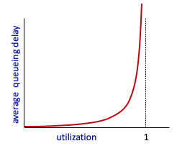


Caching example
Scenario:
access link rate: 1.54 Mbps
RTT from institutional router to server: 2 sec
web object size: 100K bits
average request rate from browsers to origin servers: 15/sec
avg data rate to browsers: 1.50 Mbps
origin
servers
public
Internet
1.54 Mbps
access link
Performance:
access link utilization = .97
LAN utilization: .0015
end-end delay = Internet delay +
access link delay + LAN delay
= 2 sec + minutes + usecs
problem: large queueing delays at high utilization!
institutional
network
1 Gbps LAN
Notes:
explain why minutes (recall earlier delay versus arrival rate curve from Chapter 1)

Slide 30
Option 1: buy a faster access link
Scenario:
access link rate: 1.54 Mbps
RTT from institutional router to server: 2 sec
web object size: 100K bits
average request rate from browsers to origin servers: 15/sec
avg data rate to browsers: 1.50 Mbps
154 Mbps
origin
servers
public
Internet
154 Mbps
1.54 Mbps
access link
Performance:
access link utilization = .97
LAN utilization: .0015
end-end delay = Internet delay +
access link delay + LAN delay
= 2 sec + minutes + usecs
.0097
institutional
network
1 Gbps LAN
Cost: faster access link (expensive!)
msecs
Notes:
t’

Slide 31
Option 2: install a web cache
Scenario:
access link rate: 1.54 Mbps
RTT from institutional router to server: 2 sec
web object size: 100K bits
average request rate from browsers to origin servers: 15/sec
avg data rate to browsers: 1.50 Mbps
origin
servers
public
Internet
1.54 Mbps
access link
Cost: web cache (cheap!)
institutional
network
Performance:
LAN utilization: .?
access link utilization = ?
average end-end delay = ?
1 Gbps LAN
How to compute link
utilization, delay?
local web cache
Notes:
t’

Slide 32
Calculating access link utilization, end-end delay with cache:
suppose cache hit rate is 0.4:
40% requests served by cache, with low (msec) delay
origin
servers
public
Internet
60% requests satisfied at origin
rate to browsers over access link
= 0.6 * 1.50 Mbps = .9 Mbps
access link utilization = 0.9/1.54 = .58 means low (msec) queueing delay at access link
1.54 Mbps
access link
institutional
network
average end-end delay:
= 0.6 * (delay from origin servers)
+ 0.4 * (delay when satisfied at cache)
= 0.6 (2.01) + 0.4 (~msecs) = ~ 1.2 secs
1 Gbps LAN
local web cache
lower average end-end delay than with 154 Mbps link (and cheaper too!)
Notes:
t’

Slide 33
Conditional GET
client
server
Goal: don’t send object if cache has up-to-date cached version
no object transmission delay (or use of network resources)
client: specify date of cached copy in HTTP request
If-modified-since: <date>
server: response contains no object if cached copy is up-to-date:
HTTP/1.0 304 Not Modified
HTTP request msg
If-modified-since: <date>
object
not
modified
before
<date>
HTTP response
HTTP/1.0
304 Not Modified
HTTP request msg
If-modified-since: <date>
object
modified
after
<date>
HTTP response
HTTP/1.0 200 OK
<data>
Notes:
t’

Slide 34
HTTP/2
Key goal: decreased delay in multi-object HTTP requests
HTTP1.1: introduced multiple, pipelined GETs over single TCP connection
server responds in-order (FCFS: first-come-first-served scheduling) to GET requests
with FCFS, small object may have to wait for transmission (head-of-line (HOL) blocking) behind large object(s)
loss recovery (retransmitting lost TCP segments) stalls object transmission
Notes:
t’

Slide 35
HTTP/2
Key goal: decreased delay in multi-object HTTP requests
HTTP/2: [RFC 7540, 2015] increased flexibility at server in sending objects to client:
methods, status codes, most header fields unchanged from HTTP 1.1
transmission order of requested objects based on client-specified object priority (not necessarily FCFS)
push unrequested objects to client
divide objects into frames, schedule frames to mitigate HOL blocking
Notes:
t’

Slide 36
HTTP/2: mitigating HOL blocking
HTTP 1.1: client requests 1 large object (e.g., video file) and 3 smaller objects
server
GET O₄
GET O₃
GET O₂
GET O₁
object data requested
client
O₁
O₂
O₁
O₃
O₂
O₃
O₄
O₄
objects delivered in order requested: O₂, O₃, O₄ wait behind O₁
Notes:
t’

Slide 37
HTTP/2: mitigating HOL blocking
HTTP/2: objects divided into frames, frame transmission interleaved
server
GET O₄
GET O₃
GET O₂
GET O₁
object data requested
client
O₂
O₄
O₃
O₁
O₂
O₃
O₄
O₁
O₂, O₃, O₄ delivered quickly, O₁ slightly delayed
Notes:
shortest job first: decreased average delay!

Slide 38
HTTP/2 to HTTP/3
HTTP/2 over single TCP connection means:
recovery from packet loss still stalls all object transmissions
as in HTTP 1.1, browsers have incentive to open multiple parallel TCP connections to reduce stalling, increase overall throughput
no security over vanilla TCP connection
HTTP/3: adds security, per object error- and congestion-control (more pipelining) over UDP
more on HTTP/3 in transport layer
Notes:
t’

Slide 39

FTP: the file transfer protocol
file transfer
FTP
user
interface
FTP
client
FTP
server
user
at host
remote file
system
local file
system
transfer file to/from remote host
client/server model
client: side that initiates transfer (either to/from remote)
server: remote host
ftp: RFC 959
ftp server: port 21

Slide 40
FTP: separate control, data connections
FTP client contacts FTP server at port 21, using TCP
client authorized over control connection
client browses remote directory, sends commands over control connection
when server receives file transfer command, server opens 2nd TCP data connection (for file) to client
after transferring one file, server closes data connection
TCP control connection,
server port 21
FTP
client
TCP data connection,
server port 20
FTP
server
server opens another TCP data connection to transfer another file
control connection: “out of band”
FTP server maintains “state”: current directory, earlier authentication

Slide 41
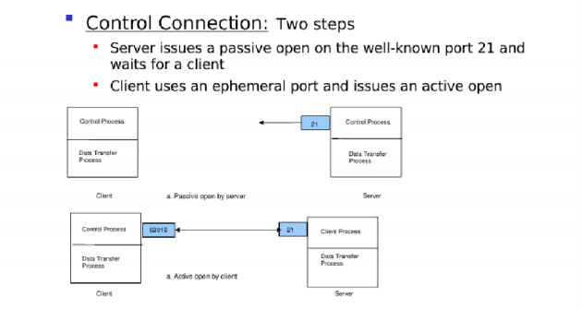
FTP: Control Connections

Slide 42
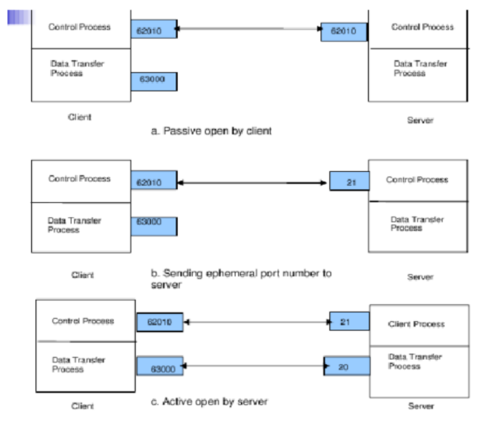
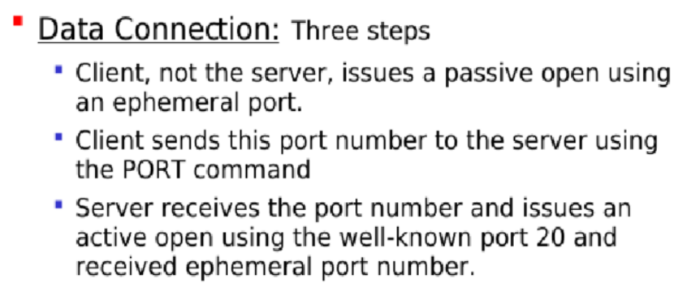
FTP: Data Connections

Slide 43
E-mail
user
agent
Three major components:
user agents
mail servers
simple mail transfer protocol: SMTP
User Agent
a.k.a. “mail reader”
composing, editing, reading mail messages
e.g., Outlook, iPhone mail client
outgoing, incoming messages stored on server
mail
server
user
agent
SMTP
mail
server
user
agent
SMTP
SMTP
user
agent
mail
server
user
agent
user
agent
outgoing
message queue
user mailbox

Slide 44
E-mail: mail servers
user
agent
mail servers:
mailbox contains incoming messages for user
message queue of outgoing (to be sent) mail messages
SMTP protocol between mail servers to send email messages
client: sending mail server
“server”: receiving mail server
mail
server
user
agent
SMTP
mail
server
user
agent
SMTP
SMTP
user
agent
mail
server
user
agent
user
agent
outgoing
message queue
user mailbox

Slide 45
SMTP RFC (5321)
“client”
SMTP server
“server”
SMTP server
uses TCP to reliably transfer email message from client (mail server initiating connection) to server, port 25
direct transfer: sending server (acting like client) to receiving server
three phases of transfer
SMTP handshaking (greeting)
SMTP transfer of messages
SMTP closure
command/response interaction (like HTTP)
commands: ASCII text
response: status code and phrase
initiate TCP
connection
RTT
TCP connection
initiated
220
SMTP handshaking
HELO
250 Hello
SMTP transfers
time

Slide 46

Scenario: Alice sends e-mail to Bob
1) Alice uses UA to compose e-mail message “to” bob@someschool.edu
4) SMTP client sends Alice’s message over the TCP connection
2) Alice’s UA sends message to her mail server using SMTP; message placed in message queue
5) Bob’s mail server places the message in Bob’s mailbox
3) client side of SMTP at mail server opens TCP connection with Bob’s mail server
6) Bob invokes his user agent to read message
user
agent
mail
server
user
agent
1
mail
server
2
3
6
4
Alice’s mail server
5
Bob’s mail server

Slide 47
Sample SMTP interaction
S: 220 hamburger.edu
C: HELO crepes.fr
S: 250 Hello crepes.fr, pleased to meet you
C: MAIL FROM: <alice@crepes.fr>
S: 250 alice@crepes.fr... Sender ok
C: RCPT TO: <bob@hamburger.edu>
S: 250 bob@hamburger.edu ... Recipient ok
C: DATA
S: 354 Enter mail, end with "." on a line by itself
C: Do you like ketchup?
C: How about pickles?
C: .
S: 250 Message accepted for delivery
C: QUIT
S: 221 hamburger.edu closing connection

Slide 48
SMTP: observations
comparison with HTTP:
HTTP: client pull
SMTP: client push
both have ASCII command/response interaction, status codes
HTTP: each object encapsulated in its own response message
SMTP: multiple objects sent in multipart message
SMTP uses persistent connections
SMTP requires message (header & body) to be in 7-bit ASCII
SMTP server uses CRLF.CRLF to determine end of message

Slide 49
Mail message format
SMTP: protocol for exchanging e-mail messages, defined in RFC 5321 (like RFC 7231 defines HTTP)
RFC 2822 defines syntax for e-mail message itself (like HTML defines syntax for web documents)
header lines, e.g.,
To:
From:
Subject:
these lines, within the body of the email message area different from SMTP MAIL FROM:, RCPT TO: commands!
Body: the “message” , ASCII characters only
header
blank
line
body

Slide 50
Retrieving email: mail access protocols
user
agent
e-mail access
protocol
user
agent
SMTP
SMTP
(e.g., IMAP, HTTP)
sender’s e-mail
server
receiver’s e-mail
server
SMTP: delivery/storage of e-mail messages to receiver’s server
mail access protocol: retrieval from server
IMAP: Internet Mail Access Protocol [RFC 3501]: messages stored on server, IMAP provides retrieval, deletion, folders of stored messages on server
HTTP: gmail, Hotmail, Yahoo!Mail, etc. provides web-based interface on top of STMP (to send), IMAP (or POP) to retrieve e-mail messages

Slide 51
POP3 protocol
S: +OK POP3 server ready
C: user bob
S: +OK
C: pass hungry
S: +OK user successfully logged on
authorization phase
client commands:
user: declare username
pass: password
server responses
+OK
-ERR
transaction phase, client:
list: list message numbers
retr: retrieve message by number
dele: delete
quit
C: list
S: 1 498
S: 2 912
S: .
C: retr 1
S: <message 1 contents>
S: .
C: dele 1
C: retr 2
S: <message 1 contents>
S: .
C: dele 2
C: quit
S: +OK POP3 server signing off

Slide 52
POP3 (more) and IMAP
more about POP3
previous example uses POP3 “download and delete” mode
Bob cannot re-read e-mail if he changes client
POP3 “download-and-keep”: copies of messages on different clients
POP3 is stateless across sessions
IMAP
keeps all messages in one place: at server
allows user to organize messages in folders
keeps user state across sessions:
names of folders and mappings between message IDs and folder name

Slide 53
DNS: Domain Name System
people: many identifiers:
SSN, name, passport #
Internet hosts, routers:
IP address (32 bit) - used for addressing datagrams
“name”, e.g., cs.umass.edu - used by humans
Q: how to map between IP address and name, and vice versa ?
Domain Name System (DNS):
distributed database implemented in hierarchy of many name servers
application-layer protocol: hosts, DNS servers communicate to resolve names (address/name translation)
note: core Internet function, implemented as application-layer protocol
complexity at network’s “edge”

Slide 54
DNS: services, structure
DNS services:
hostname-to-IP-address translation
host aliasing
canonical, alias names
mail server aliasing
load distribution
replicated Web servers: many IP addresses correspond to one name
Q: Why not centralize DNS?
single point of failure
traffic volume
distant centralized database
maintenance
A: doesn‘t scale!
Comcast DNS servers alone: 600B DNS queries/day
Akamai DNS servers alone: 2.2T DNS queries/day

Slide 55
DNS: a distributed, hierarchical database
Root DNS Servers
Root
…
…
.com DNS servers
.org DNS servers
.edu DNS servers
Top Level Domain
…
…
…
…
yahoo.com
DNS servers
amazon.com
DNS servers
pbs.org
DNS servers
nyu.edu
DNS servers
umass.edu
DNS servers
Authoritative
Client wants IP address for www.amazon.com; 1st approximation:
client queries root server to find .com DNS server
client queries .com DNS server to get amazon.com DNS server
client queries amazon.com DNS server to get IP address for www.amazon.com

Slide 56
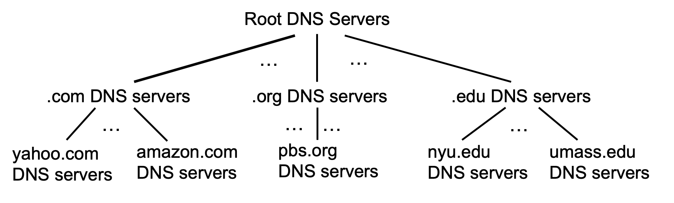
DNS: root name servers
official, contact-of-last-resort by name servers that can not resolve name

Slide 57
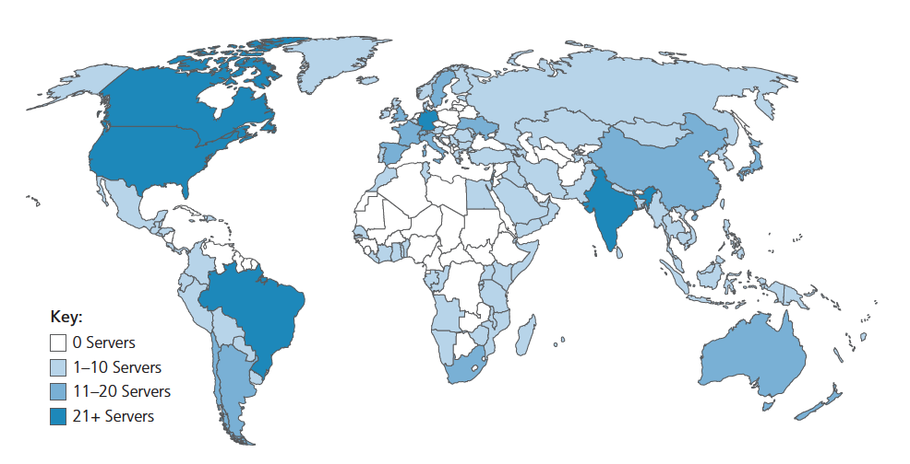
DNS: root name servers
official, contact-of-last-resort by name servers that can not resolve name
incredibly important Internet function
Internet couldn’t function without it!
DNSSEC – provides security (authentication, message integrity)
ICANN (Internet Corporation for Assigned Names and Numbers) manages root DNS domain
13 logical root name “servers” worldwide each “server” replicated many times (~200 servers in US)

Slide 58
Top-Level Domain, and authoritative servers
Top-Level Domain (TLD) servers:
responsible for .com, .org, .net, .edu, .aero, .jobs, .museums, and all top-level country domains, e.g.: .cn, .uk, .fr, .ca, .jp
Network Solutions: authoritative registry for .com, .net TLD
Educause: .edu TLD
authoritative DNS servers:
organization’s own DNS server(s), providing authoritative hostname to IP mappings for organization’s named hosts
can be maintained by organization or service provider

Slide 59
Local DNS name servers
when host makes DNS query, it is sent to its local DNS server
Local DNS server returns reply, answering:
from its local cache of recent name-to-address translation pairs (possibly out of date!)
forwarding request into DNS hierarchy for resolution
each ISP has local DNS name server; to find yours:
MacOS: % scutil --dns
Windows: >ipconfig /all
local DNS server doesn’t strictly belong to hierarchy

Slide 60
DNS name resolution: iterated query
root DNS server
Example: host at engineering.nyu.edu wants IP address for gaia.cs.umass.edu
2
3
TLD DNS server
Iterated query:
contacted server replies with name of server to contact
“I don’t know this name, but ask this server”
1
4
8
5
requesting host at
engineering.nyu.edu
local DNS server
dns.nyu.edu
gaia.cs.umass.edu
7
6
authoritative DNS server
dns.cs.umass.edu

Slide 61
DNS name resolution: recursive query
root DNS server
Example: host at engineering.nyu.edu wants IP address for gaia.cs.umass.edu
2
3
7
6
Recursive query:
puts burden of name resolution on contacted name server
heavy load at upper levels of hierarchy?
1
TLD DNS server
8
requesting host at
engineering.nyu.edu
local DNS server
dns.nyu.edu
5
4
gaia.cs.umass.edu
authoritative DNS server
dns.cs.umass.edu

Slide 62
Caching DNS Information
once (any) name server learns mapping, it caches mapping, and immediately returns a cached mapping in response to a query
caching improves response time
cache entries timeout (disappear) after some time (TTL)
TLD servers typically cached in local name servers
cached entries may be out-of-date
if named host changes IP address, may not be known Internet-wide until all TTLs expire!
best-effort name-to-address translation!

Slide 63
DNS records
DNS: distributed database storing resource records (RR)
RR format: (name, value, type, ttl)
type=A
name is hostname
value is IP address
type=CNAME
name is alias name for some “canonical” (the real) name
www.ibm.com is really servereast.backup2.ibm.com
value is canonical name
type=NS
name is domain (e.g., foo.com)
value is hostname of authoritative name server for this domain
type=MX
value is name of SMTP mail server associated with name

Slide 64
Getting your info into the DNS
example: new startup “Network Utopia”
register name networkuptopia.com at DNS registrar (e.g., Network Solutions)
provide names, IP addresses of authoritative name server (primary and secondary)
registrar inserts NS, A RRs into .com TLD server:
(networkutopia.com, dns1.networkutopia.com, NS)
(dns1.networkutopia.com, 212.212.212.1, A)
create authoritative server locally with IP address 212.212.212.1
type A record for www.networkuptopia.com
type MX record for networkutopia.com

